Slide 1
DESTINATION OPTION FOR IPv6
Vijay J
PES2UG20CS815

Slide 2
Introductions
The Destination Options header is used to specify packet delivery parameters for either intermediate destinations or the final destination.
This header is identified by the value of 60 in the previous header’s Next Header field.
The Destination Options header has the same structure as the Hop-by-Hop Options header.
This has a “Destination Options” header, as defined in RFC 2460

Slide 3
Purpose of the Protocol
If Destination Header is present before Routing Header then it will be examined by all intermediate nodes specified in the routing header.
If Destination Header is present just above the Upper layer then it will be examined only by the Destination node.

Slide 4

Structure of the Destination Option for IPv6
The structure of the Destination Options header

Slide 5
Structure of the Destination Option for IPv6
Next Header - 8-bit selector. Identifies the type of header immediately following the Destination Options header. Uses the same values as the Ipv4 Protocol field [RFC-1700 et seq.].
Header Extension Length - 8-bit unsigned integer. Length of the Destination Options header in 8-octet units, not including the first 8 octets.
Options - Variable-length field, of length such that the complete Destination Options header is an integer multiple of 8 octets long. Contains one or more TLV-encoded options

Slide 6
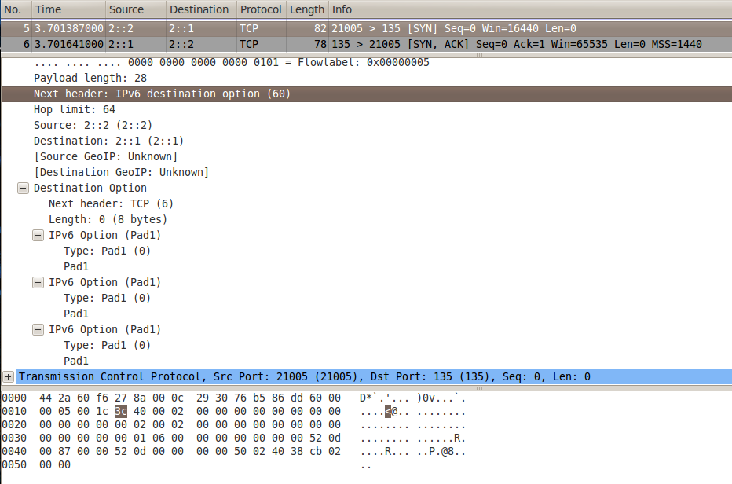
Test 5 of firewall6 sends this packet

Slide 7
Usage of Destination Option for IPv6
If a Routing header is present, it specifies delivery or processing options at each intermediate destination.
It specifies delivery or processing options at the final destination.

Slide 8
Conclusions
Ipv6 Destination Option headers add features and flexibility.
Destination Options Header within Ipv6 allows the binding messages to only being examined at the ultimate destination. Hence, the intermediate routers between source and destination are spared the performance degradation caused by examining options contained in the binding messages.

Slide 9

Thank You

